Slide 1

Geospatial Analysis of Urban Traffic and Air Quality Data Using Clustering: A Chicago Case Study
Abdullah Soubhi Abdulkarim U24107870
Mahmoud Madi U23103334
Moaaz Saed Alshehadat U24102854
Omar Alhamadi U23200847
Humaid AlHadidi U23103346

Slide 2
Objectives
Exploring Chicago air quality data and taxi mobility data and finding relationships.
Apply stratified sampling on the data.
Apply DBSCAN algorithm on PM2.5 values.
Spatial join of air quality and mobility data based on GeoHash.
Modified DBSCAN on PM2.5 values and PM2.5 + mobility data.

Slide 3
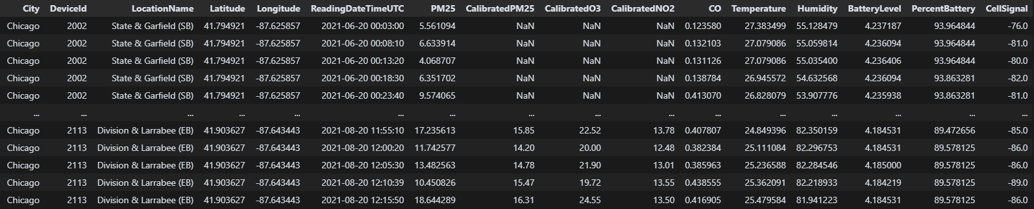
Data Exploration
Combining Chicago AIR QUALITY data from multiple CSVs (19 files)
From Jan 2021 till Oct 2021
2,461,089 rows × 16 columns

Slide 4
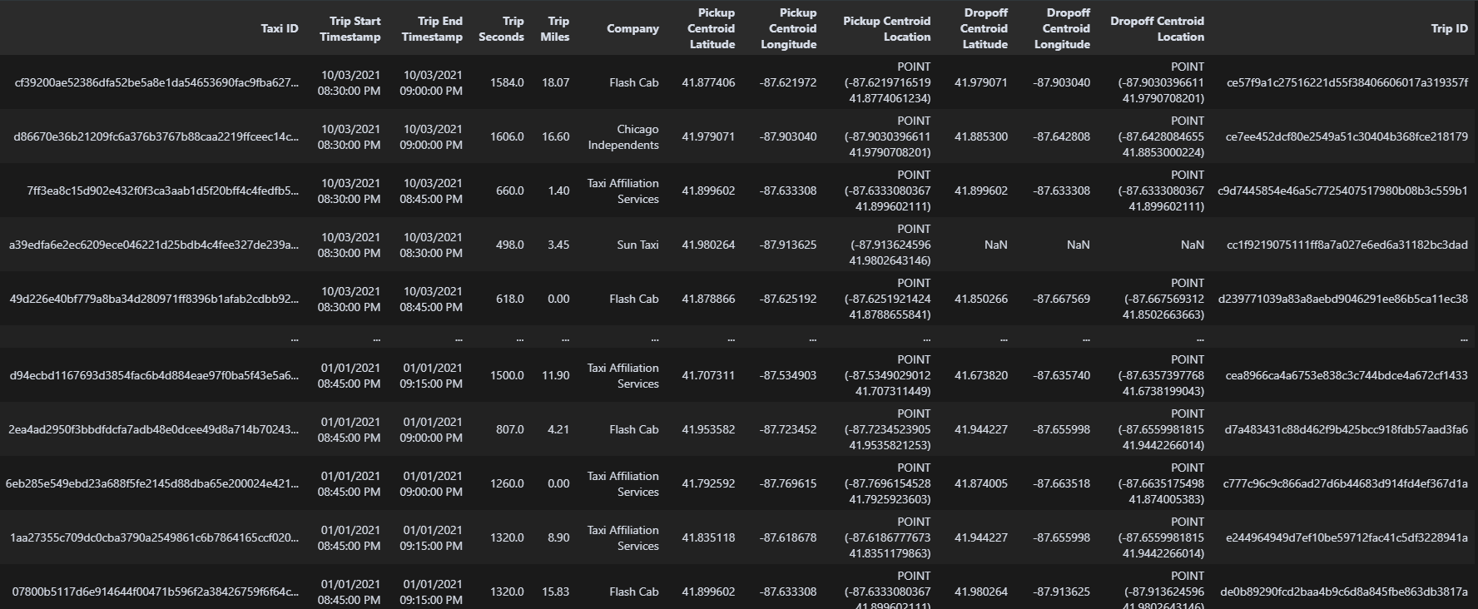
Data Exploration
Chicago TAXI data
From Jan 2021 till Oct 2021
2,618,451 rows × 13 columns

Slide 5
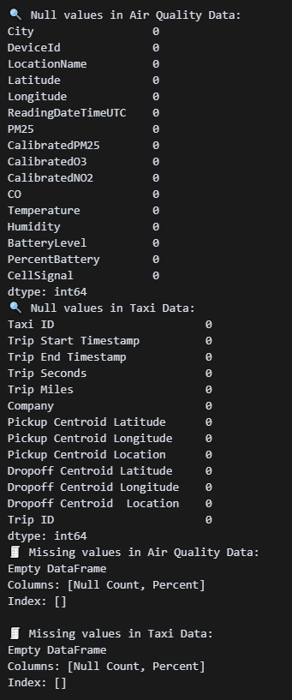
Data Exploration
Data Preprocessing
Dropping all irrelevant columns
Dropping all rows that contains missing values

Slide 6
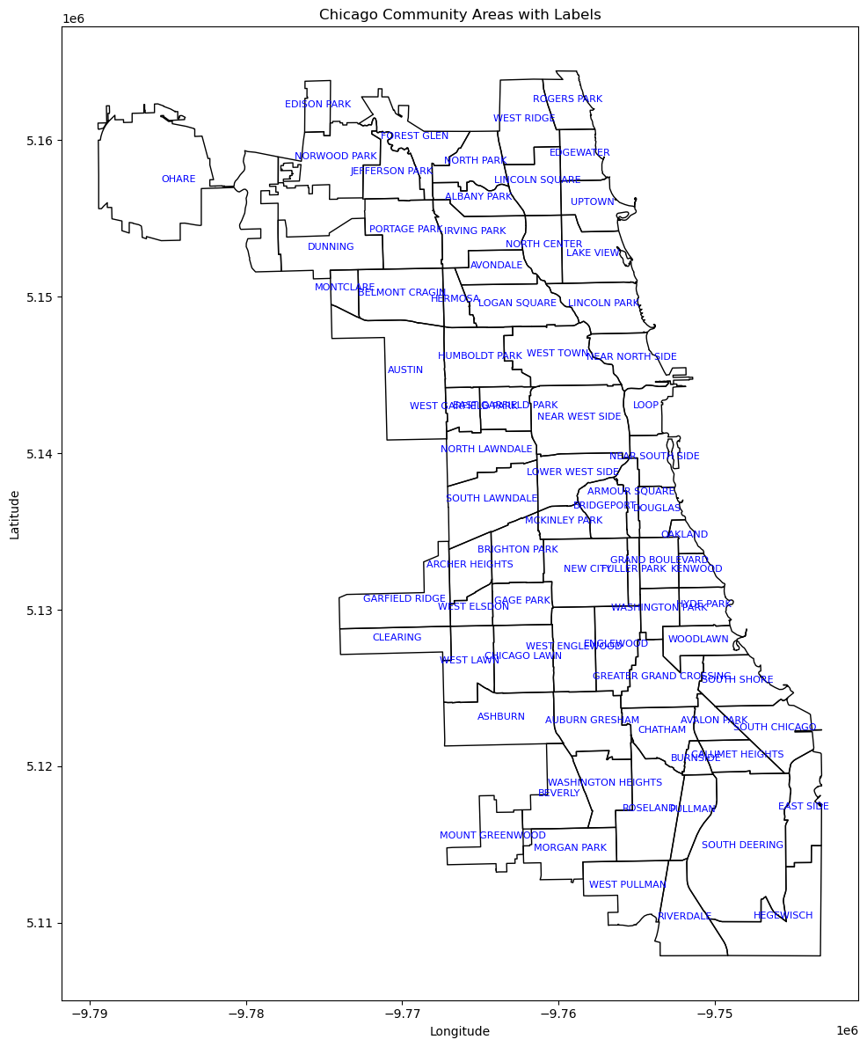
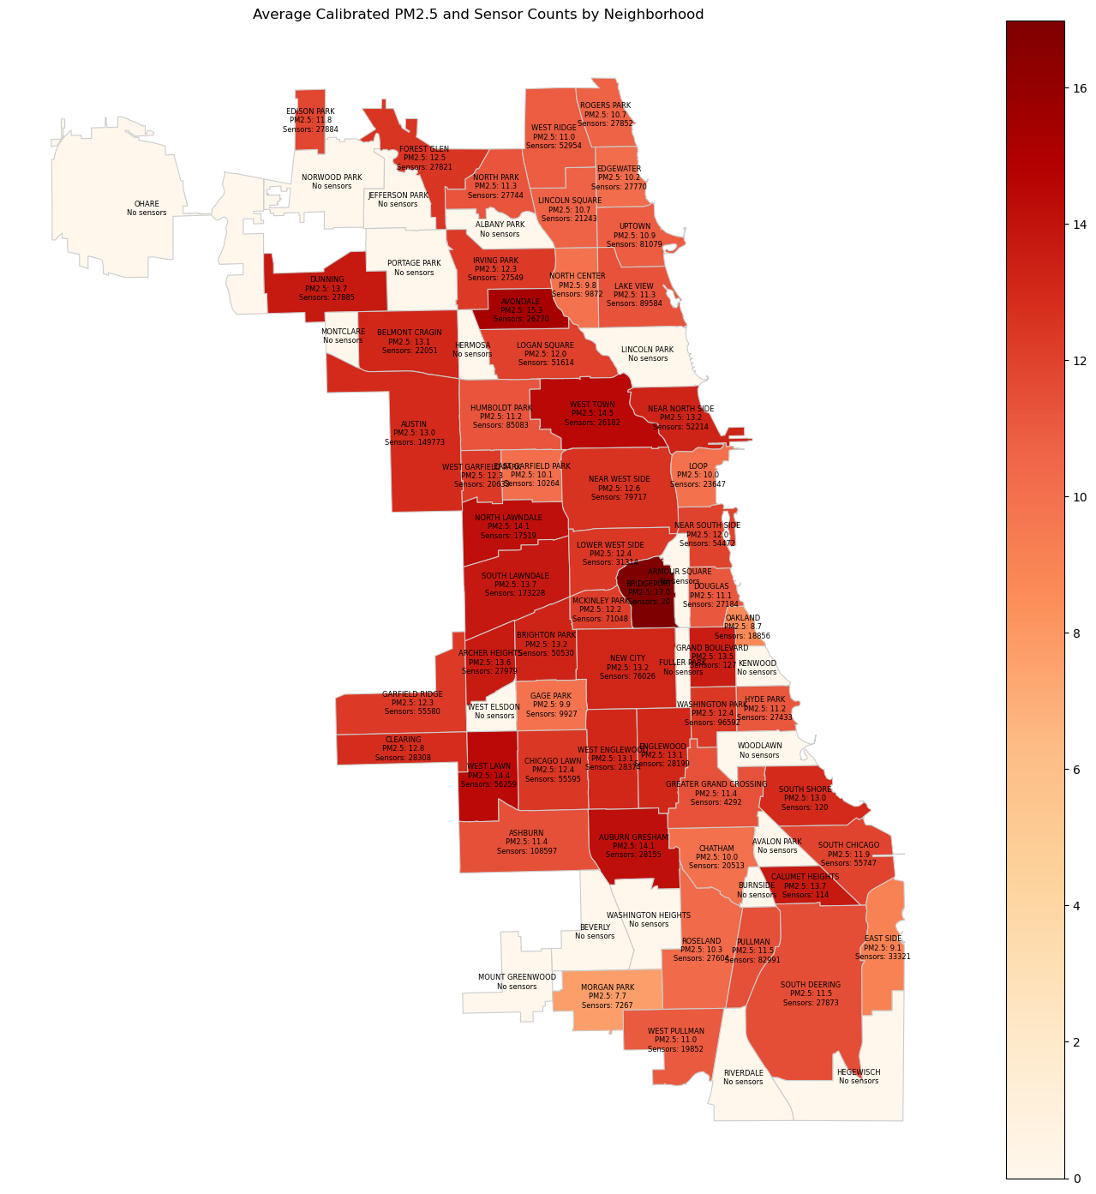
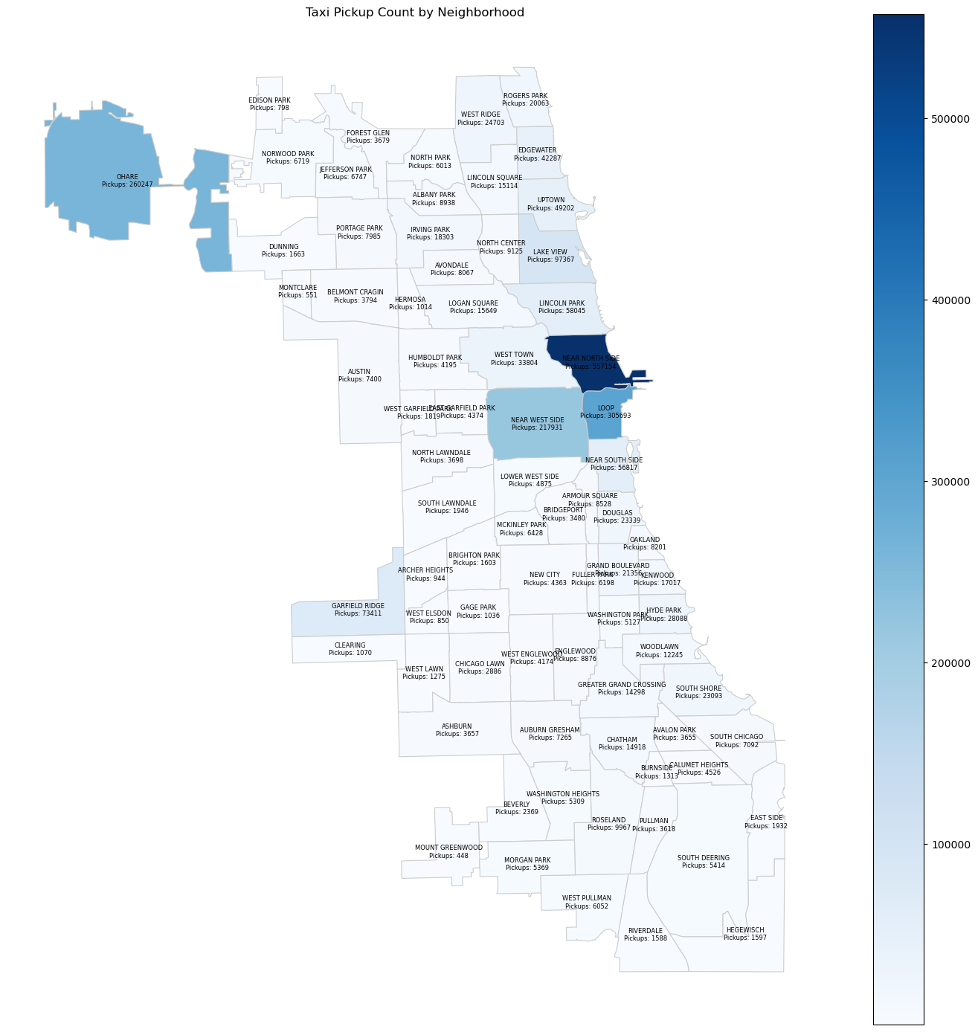
Data Exploration
Chicago Map Average PM2.5 by neighbourhood Taxi Pickup Count by Neighbourhood

Slide 7
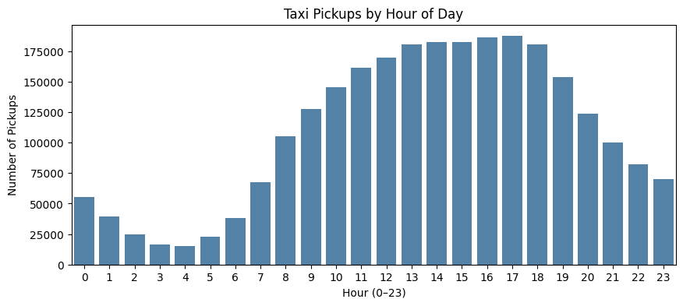
Data Exploration

Slide 8
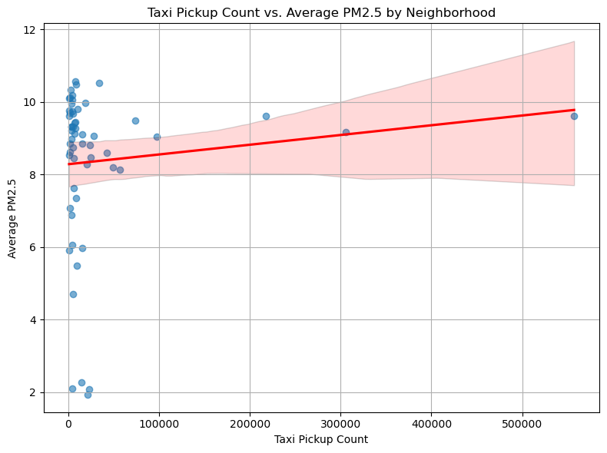
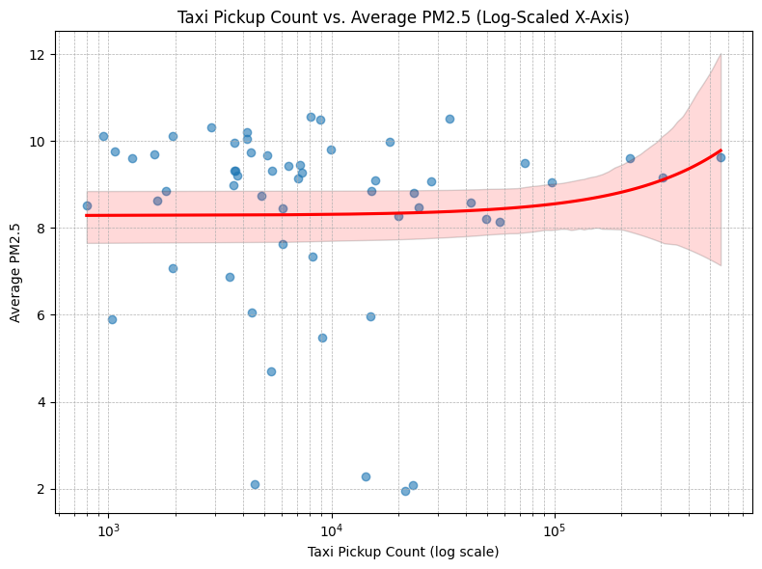
Data Exploration
Taxi Pickup Count vs. Average PM2.5 by Neighbourhood

Slide 9
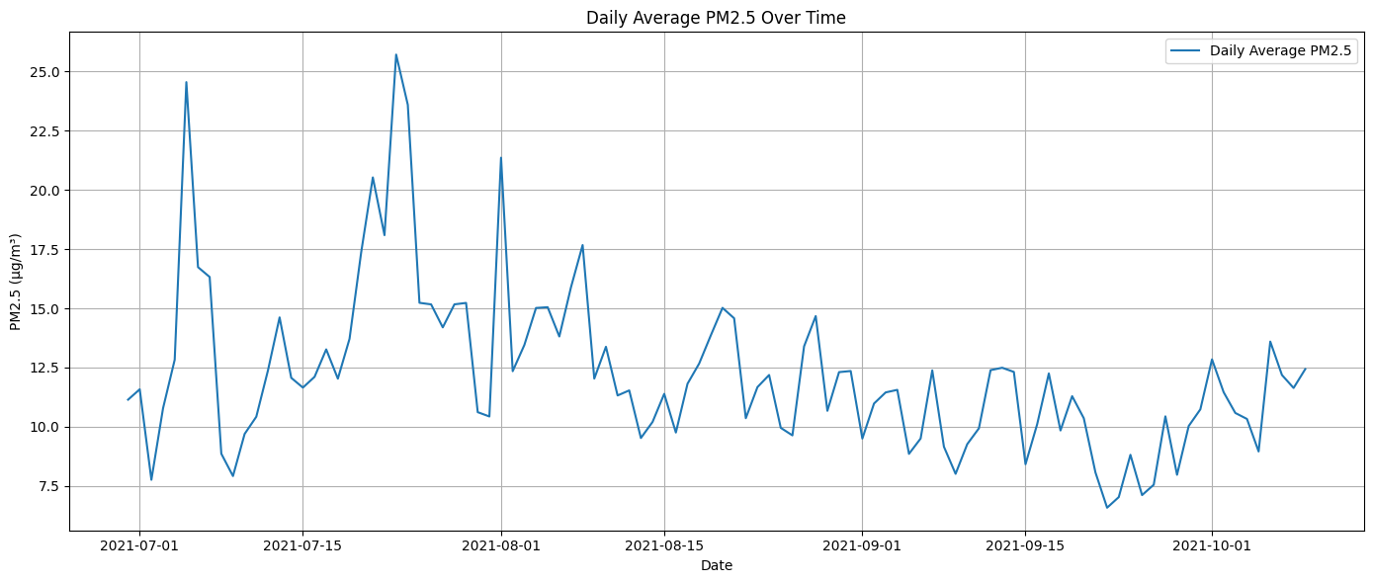
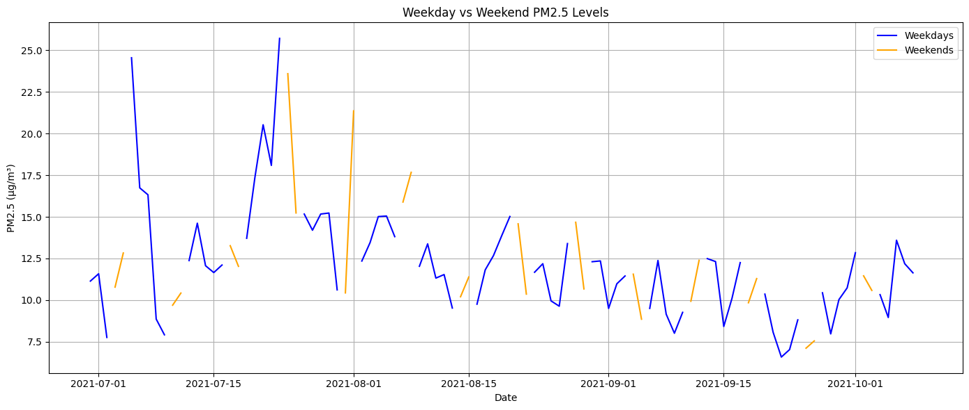
Data Exploration
Daily Average Over Time
Weekday vs. Weekend Cycles

Slide 10
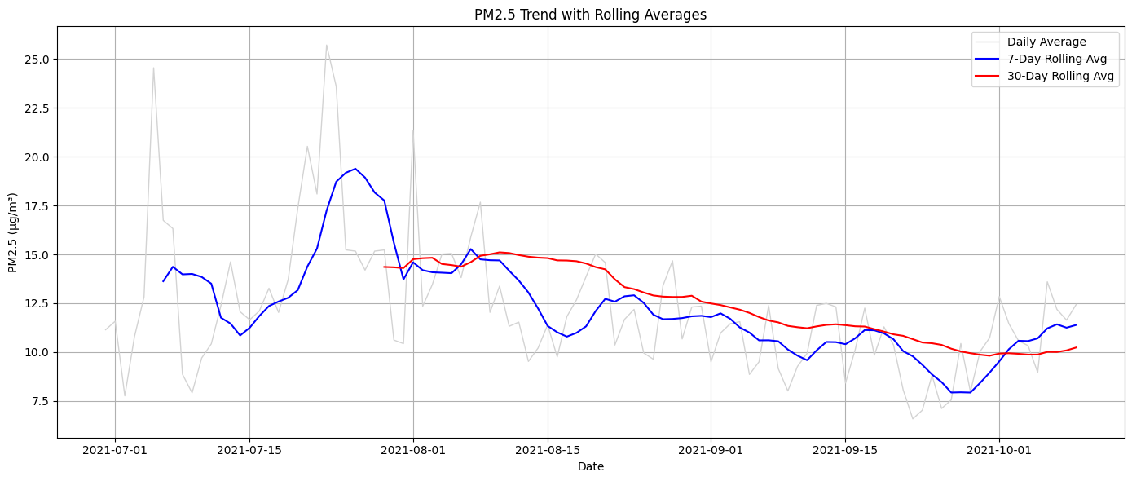
Data Exploration
Average PM2.5 (Daily, Weekly, Monthly)

Slide 11
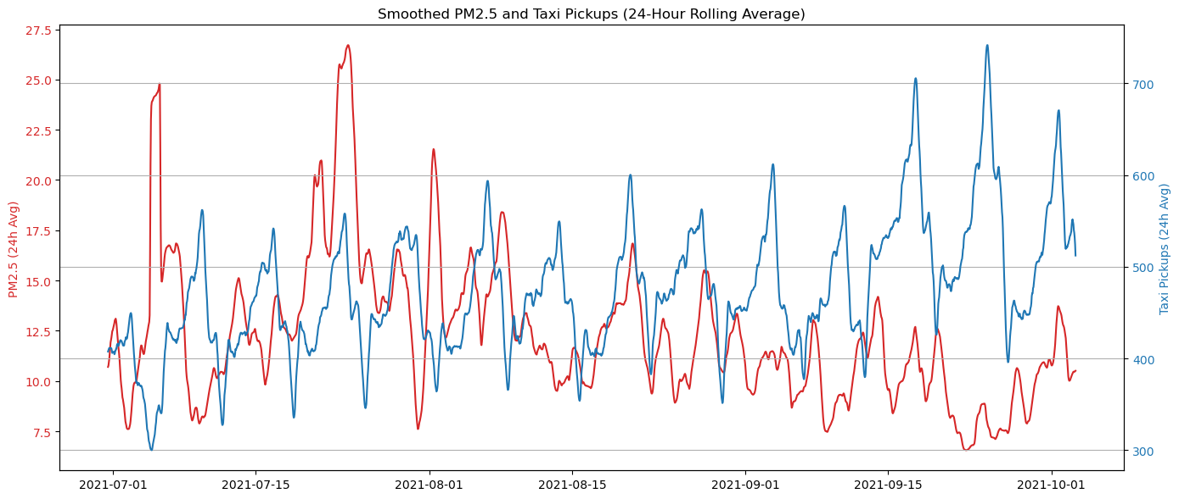
Data Exploration
Daily average PM2.5 and Taxi Pickup

Slide 12
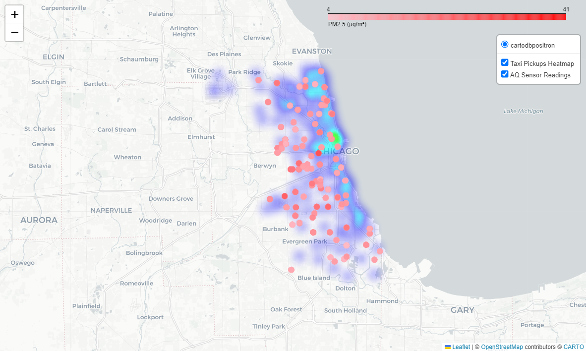
Spatial Results
Heatmap of Taxi pickups and PM2.5 pollution levels

Slide 13
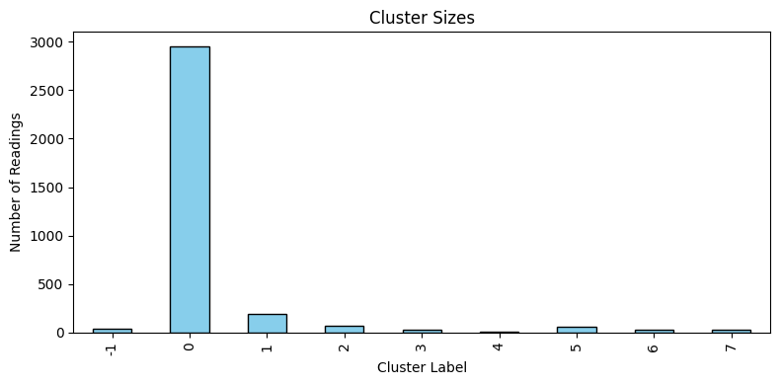
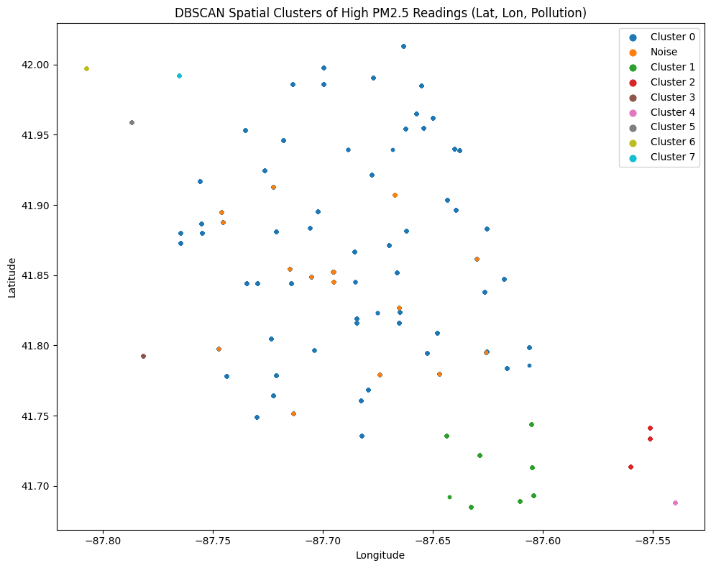
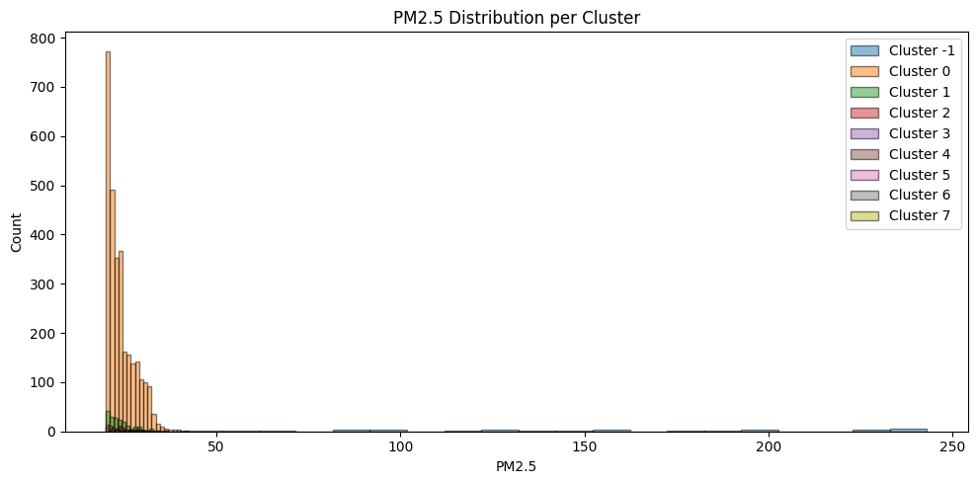
Hotspot Clusters
Applying clustering result based on PM2.5 values

Slide 14
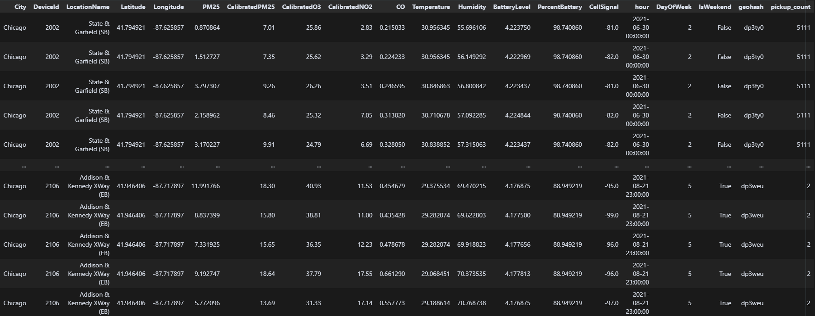
Spatial Join based on Geohash

Slide 15
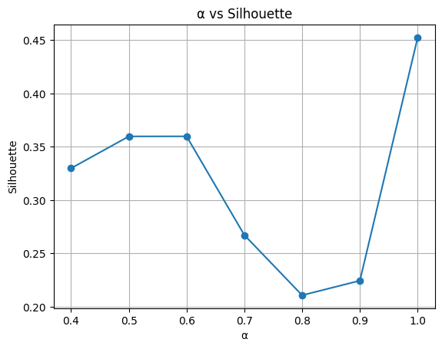
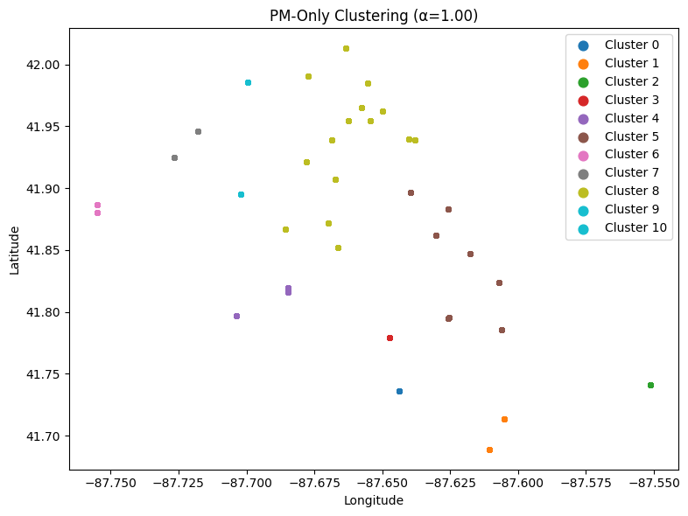

Modified DBSCAN
$$W=α W_{d}+\left(1−α\right)W_{pm}$$
$$where 0≤α≤1$$

Slide 16
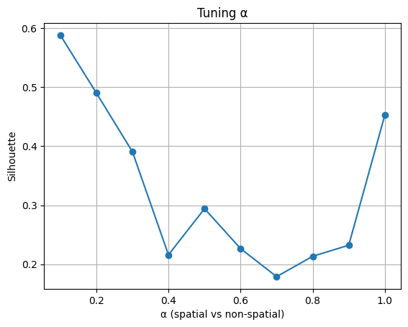
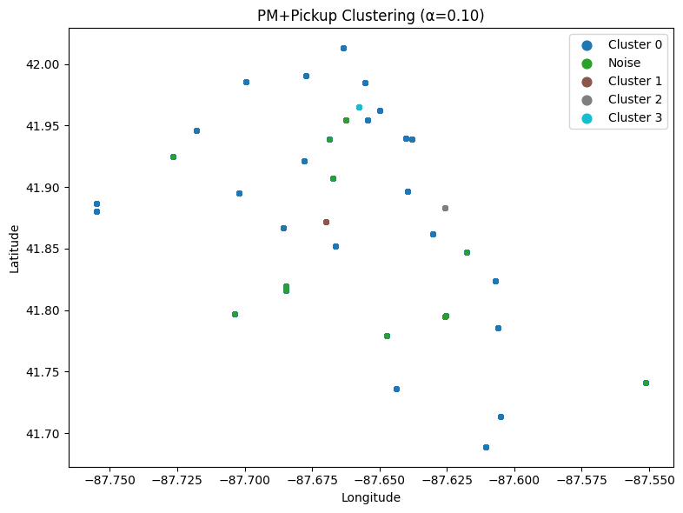

Modified DBSCAN
$$W=α W_{d}+\left(1−α\right)W_{pm+taxis}$$
$$where 0≤α≤1$$

Slide 17
Insights & Implications
Pollution “hotspots” coincide with busy roads and industrial zones
Custom clustering pinpoints exact streets and blocks needing action
Taxi traffic shows a clear, though not exclusive, link to PM2.5 spikes
Rush‐hour peaks confirm time‐of‐day traffic controls can help
Planners should focus on those hotspots for traffic flow improvements and stricter emissions enforcement

Slide 18
Future Work
Optimizing sensors placement in the city.
Exploring other sources of pollution.
Study how the green areas help reduce the pollution.
Application to help minimize pollution in key areas.

Slide 19
Conclusion
We successfully merged street‐level PM₂.₅ data with taxi pickups to reveal local pollution hotspots.
A weighted‐DBSCAN approach accurately identified the most affected blocks by combining proximity and pollution intensity.
Traffic patterns—especially morning and evening peaks—drive significant short‐term PM₂.₅ spikes.
Our clear maps and charts equip planners to target traffic flow changes and emissions controls where they matter most.
This scalable framework can be adapted for real‐time monitoring and applied in other cities.

